Slide 1
Introduction to Human Service Finance for Minnesota County Directors
by Tom Henderson and John Sellen
Brown County Hennepin County
Presented by
A 6-Video Series

Slide 2
Introduction to Human Service Finance for Minnesota County Directors
Welcome, Overview, & Basic Concepts
Cash Assistance & Health Care
Social Services Fiscal Elements
Children’s Social Services
Adult Social Services
Budgeting & Conclusion
A 6-Video Series

Slide 3
Introduction to Human Service Finance for Minnesota County Directors
5. Adult Social Services
A 6-Video Series

Slide 4
Adult Social Services
Adult Social Services include Adult Protection, Elderly Services, and Adult Mental Health.
We cover Chemical Dependency and Developmental Disabilities here, even though a portion of the clients are children.
We cover Children’s Mental Health in segment 3 on Children’s Social Services, even though some counties organize it with Adult Mental Health.

Slide 5
Finance Components
Chemical Dependency
Expenditures
Staff
Administration
Detoxification
CCDTF (Consolidated Chemical Dependency Treatment Fund) Treatment Costs
Revenue
CCDTF Treatment Allocation
CCDTF Administrative Dollars
CCDTF County Match (22.95%)
Detoxification Fees and Insurance
MA and MCO reimbursement for Rule 25 Assessments
VCA (Vulnerable Children and Adults Act including Title XX) *

Slide 6
Consolidated Chemical Dependency Treatment Fund (CCDTF)
Portion of CCDTF Treatment funds paid out so far year-to-date
(in this case,
in 4 months)
CCDTF County Share so far year-to-date (4 months)

Slide 7
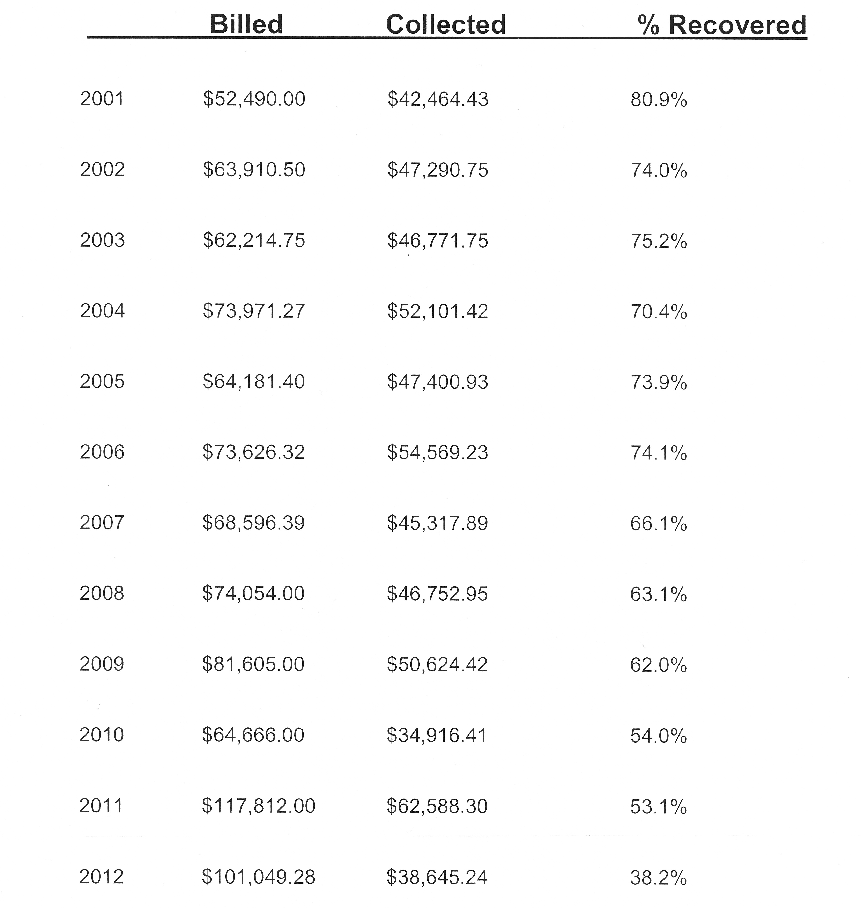
Detox Collections – Brown County Example

Slide 8
Detox Collections – Graph of Previous Slide

Slide 9
Finance Components
Adult Mental Health
Expenditures
Case Management Social Work
Pre-commitment Costs
Counseling/Assessment/Testing
Acute Care Costs
Community Support Program
ARMHS
Sex offender holds and commitments
Revenue
Adult Mental Health AMH-TCM - both DHS fee for service and PMAP
Client Fees (MA, Insurance and Client pay)
VCA (Vulnerable Children and Adults Act including Title XX) *
Adult Initiative Funds
MA-SSTS
Community Support Block Grant

Slide 10
State Facility MH Treatment Costs
At Anoka RTC counties pay:
No fee for the 1st 30 days of a placement.
From 30 to 60 days, counties are charged 20%.
After 60 days, counties pay 50% of the charges (if client is ready for discharge).
Anoka RTC’s per diem is currently $1,020 so charges range from $204/day or $510/day depending on how long a client has been there.
For persons committed to the Minnesota Security Hospital (MSH) and MN Sex Offender Program (MSOP) counties pay 10% of the cost of care for any individual civilly committed prior to July 31, 2011. Starting August 1, 2011 counties pay 25% of the cost of care for any individual civilly committed.
The per diem cost of these programs are MSH $553 and MSOP $326. Our cost for these programs are MSH $55.3/day and MSOP $81.50/day (25% rate).
Counties do not pay for persons committed to CBHH’s.
For persons on a hold order the funding structure is different but simpler. Counties pay 100% of the cost of care regardless of the placement facility. In the case of holds, counties do pay for the cost of care at a CBHH.
The CBHH per diem is currently $1,153.

Slide 11
Finance Components
Developmental Disabilities
Expenditures
Case Management
MnCHOICES Assessments
Administration
SILS (Semi-Independent Living Services)
DD Waiver (MR-RC )
Day Habilitation
Extended Employment
Respite Costs
Legal Services (Guardianship)
Revenue
MA Waiver Case Management Dollars
Vulnerable Adult & Developmental Disability VADD-TCM
MnCHOICES Revenue (through the SSTS Random Moments)
SILS (Semi-Independent Living Services) Grant
Family Support Grant
Consumer Support Grant
Waiver Pool Management

Slide 12
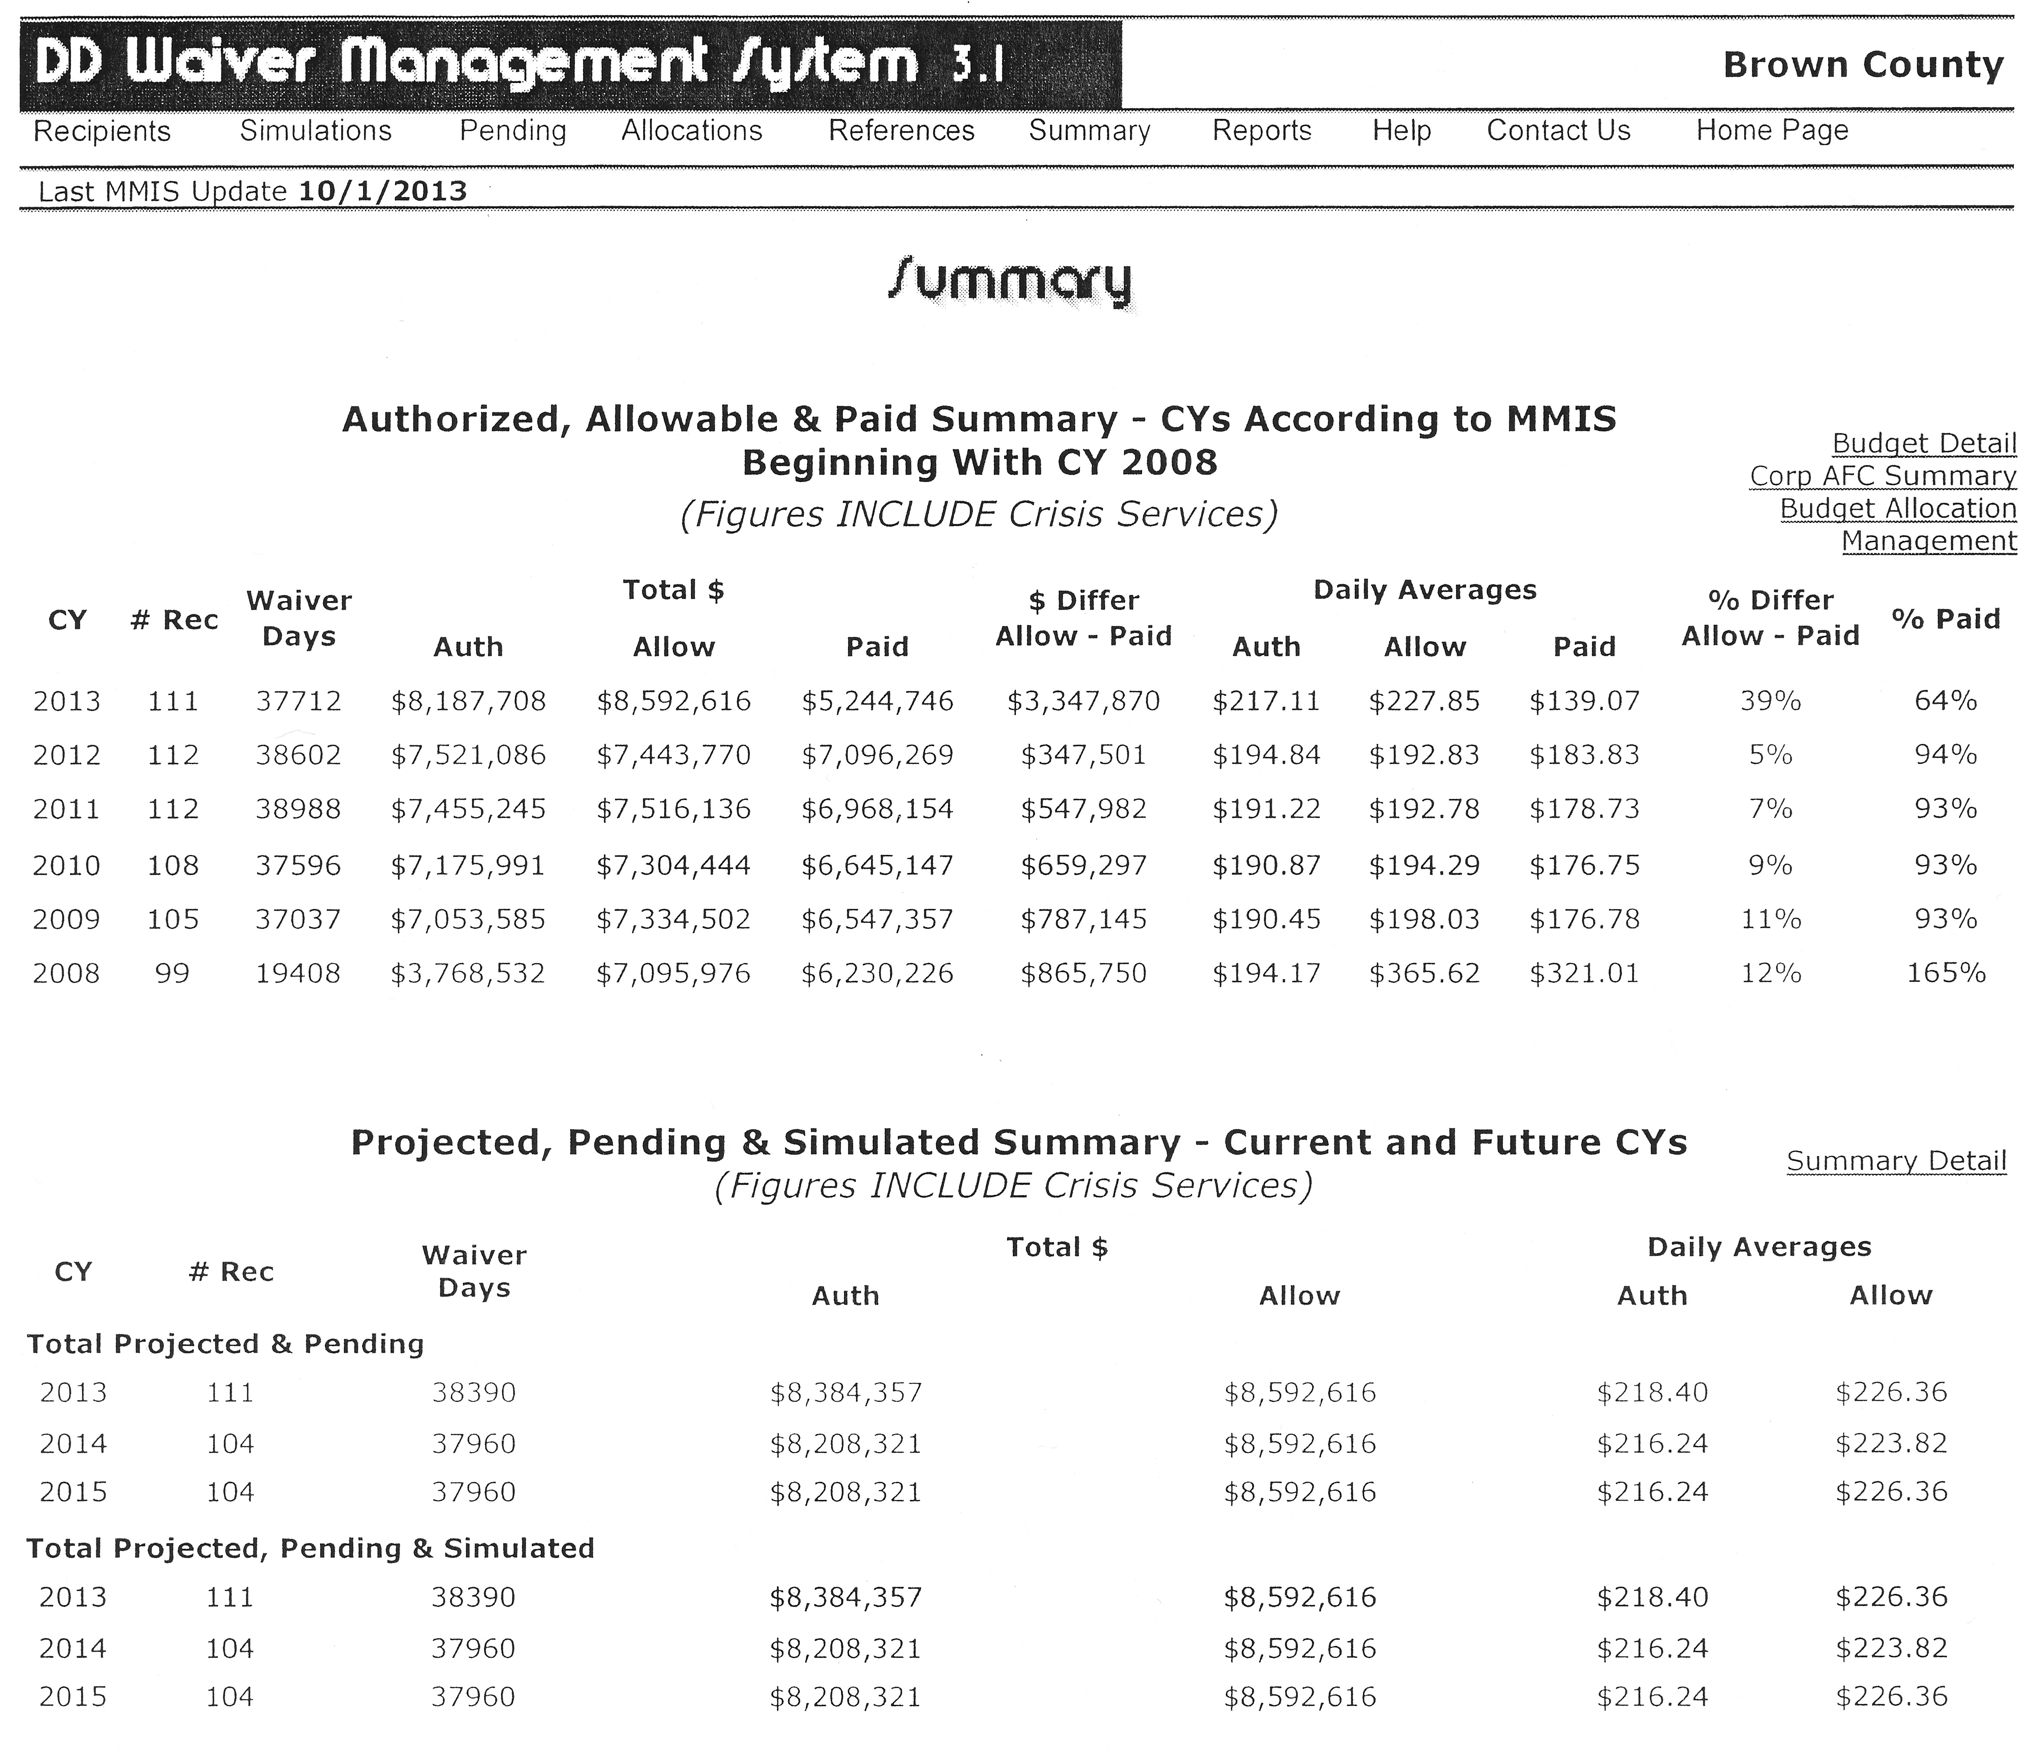
DD Waiver – Summary

Slide 13
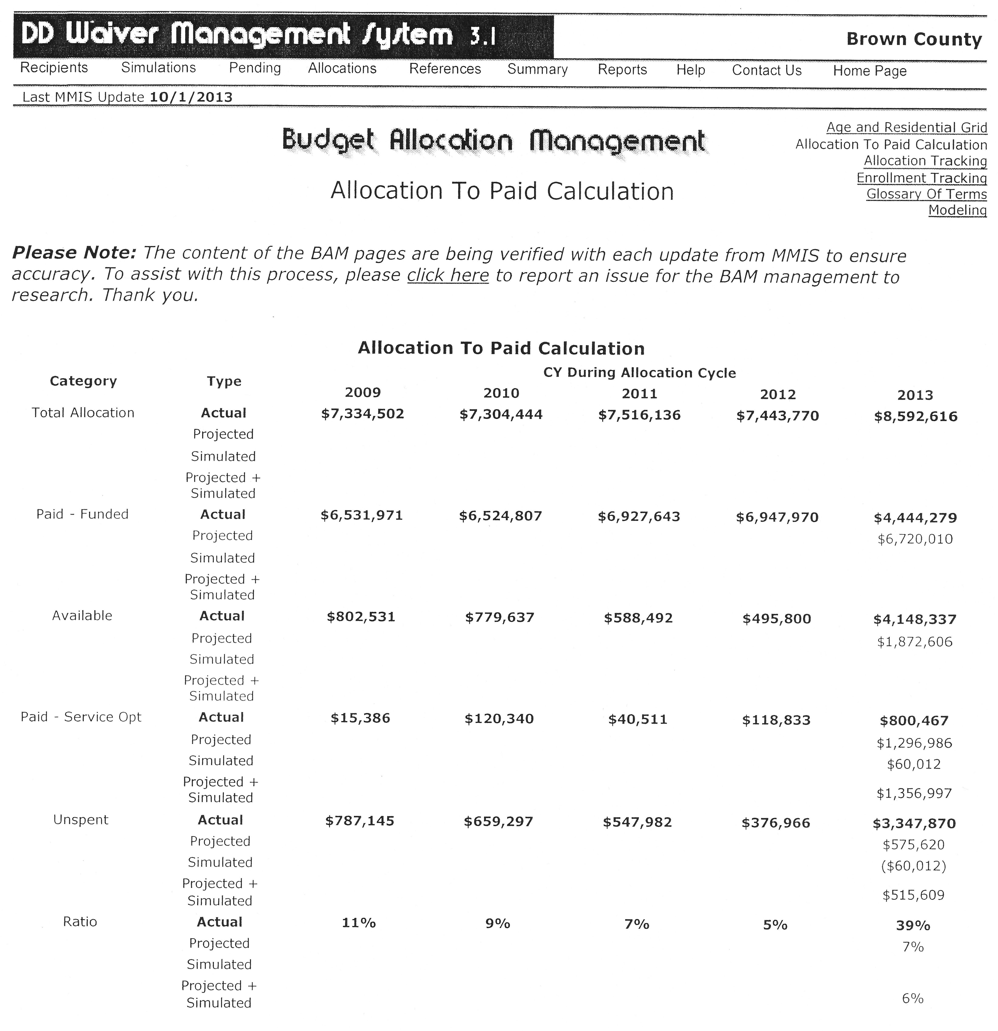
DD Waiver – Budget Allocation

Slide 14
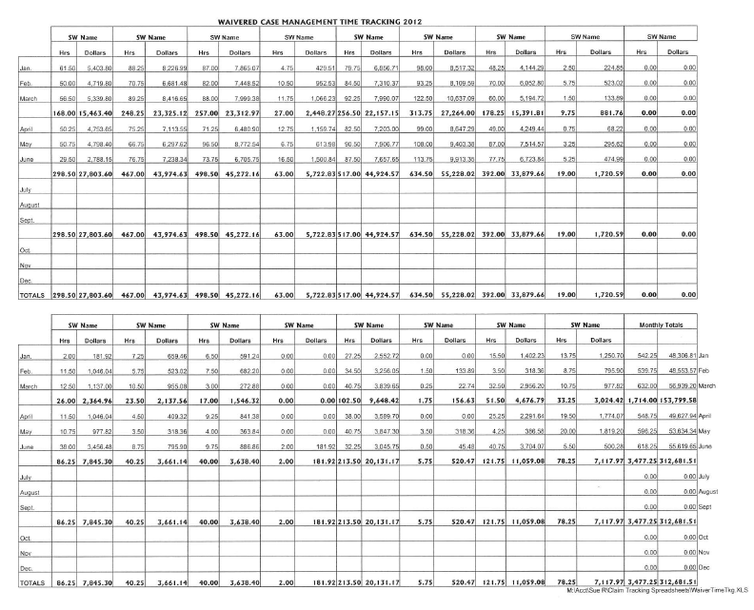
MA Waiver CM Time Tracking

Slide 15
Finance Components
Adult Services (including Elderly)
Expenditures
Case Management
Administration
MA Waivers (Elderly, CADI and Brain Injury)
MnCHOICES Assessments
Extended Employment
Legal Services (Guardianship)
Adult Foster Care
Revenue
Vulnerable Adult & Developmental Disability VADD-TCM *
VCA (Vulnerable Children and Adults Act including Title XX) *
MA Waivers (Elderly, CADI and Brain Injury) *
MnCHOICES Revenue (through the SSTS Random Moments)
RSC (Relocation Service Coordination)

Slide 16
Introduction to Human Service Finance for Minnesota County Directors
Welcome, Overview, & Basic Concepts
Cash Assistance & Health Care
Social Services Fiscal Elements
Children’s Social Services
Adult Social Services
Budgeting & Conclusion
End of Video 5

Slide 17
End of Video 5

