Slide 1

Introduction to Human Service Finance for Minnesota County Directors
by Tom Henderson and John Sellen
Brown County Hennepin County
Presented by
A 6-Video Series

Slide 2
Introduction to Human Service Finance for Minnesota County Directors
Welcome, Overview, & Basic Concepts
Cash Assistance & Health Care
Social Services Fiscal Elements
Children’s Social Services
Adult Social Services
Budgeting & Conclusion
A 6-Video Series

Slide 3
Introduction to Human Service Finance for Minnesota County Directors
6. Budgeting
& Conclusion
A 6-Video Series

Slide 4
Budgeting & Conclusion
Introduce basic budgeting concepts.
Examine budget presentation.
Look at two resources.
Consider three different budget environments.
The central role of the director and what a director should watch for.

Slide 5
Budget is a Plan
A budget is a plan to accomplish or pursue your mission for one year.
A budget represents:
  a financial plan
  an expression of priorities
  a tool for accountability
  a communication device

Slide 6
Operating Budget
Operating Budget versus Capital Budget.
Cash basis or Accrual or Modified Accrual.
We focus here on your Operating Budget (because there’s little unique about human services Capital Budget).
At its simplest, the Operating Budget includes Projected Expenditures and Anticipated Revenue.

Slide 7
Operating Budget – Revenue
Anticipated Revenue
Property tax
Capped federal, state, and other grants
Uncapped federal and state revenue
Fees and recoveries
Typically organized by major program area or by federal, state, other revenue (or both).

Slide 8

Operating Budget – Expenditures
Projected Expenditures
Services purchased for clients
Cash or other assistance directed to clients
Direct staff costs
Indirect overhead costs (not useless - very important - but indirect)
Typically organized by major program area or by object categories such as those above (or both).

Slide 9
Operating Budget – Process
Your Board will be interested in everything, but they will particularly care about the county property tax funds in your budget.
Most of us have to project expenditures and revenue separately, then go back and adjust expenditures down (or more rarely revenue up) to meet the revenue that can be realistically expected.
The difference is your change in fund balance – up, down, or neutral.

Slide 10
Budget Presentation
Budget presentations vary.
Depends on the size of the county.
Depends on whether you are presenting directly to the Board, to an Administrator, or first one and then the other.
What are you trying to accomplish with the Board or Administrator?
How to communicate effectively?
What level of detail?

Slide 11
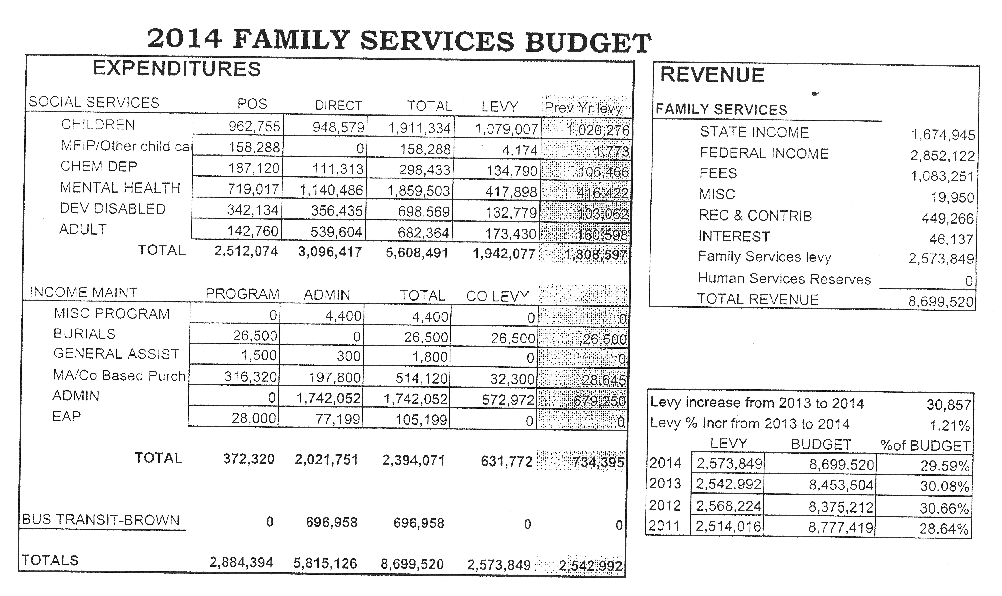
Brown County Budget Summary

Slide 12
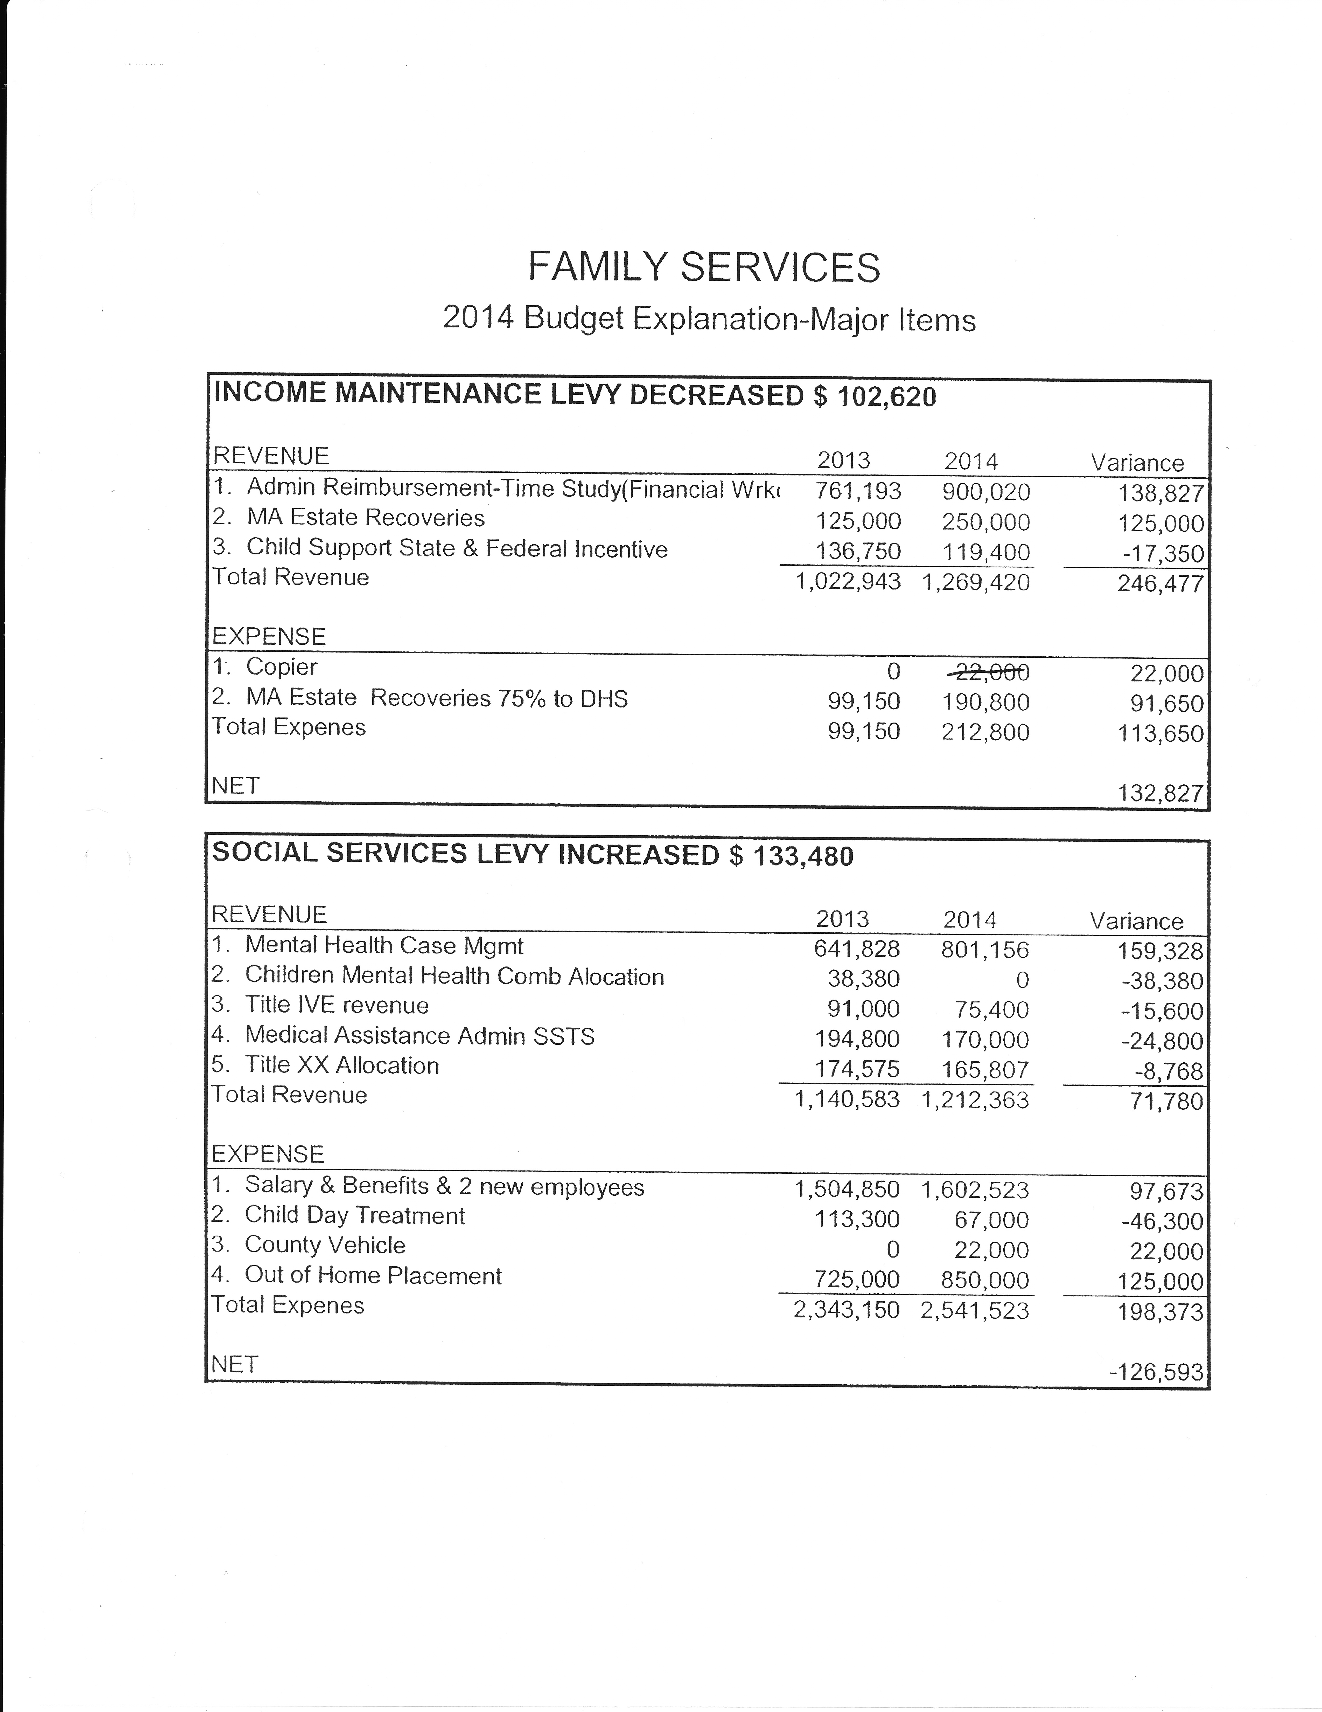
Brown County Budget – Major Items

Slide 13
Brown County Budget – Major Items

Slide 14
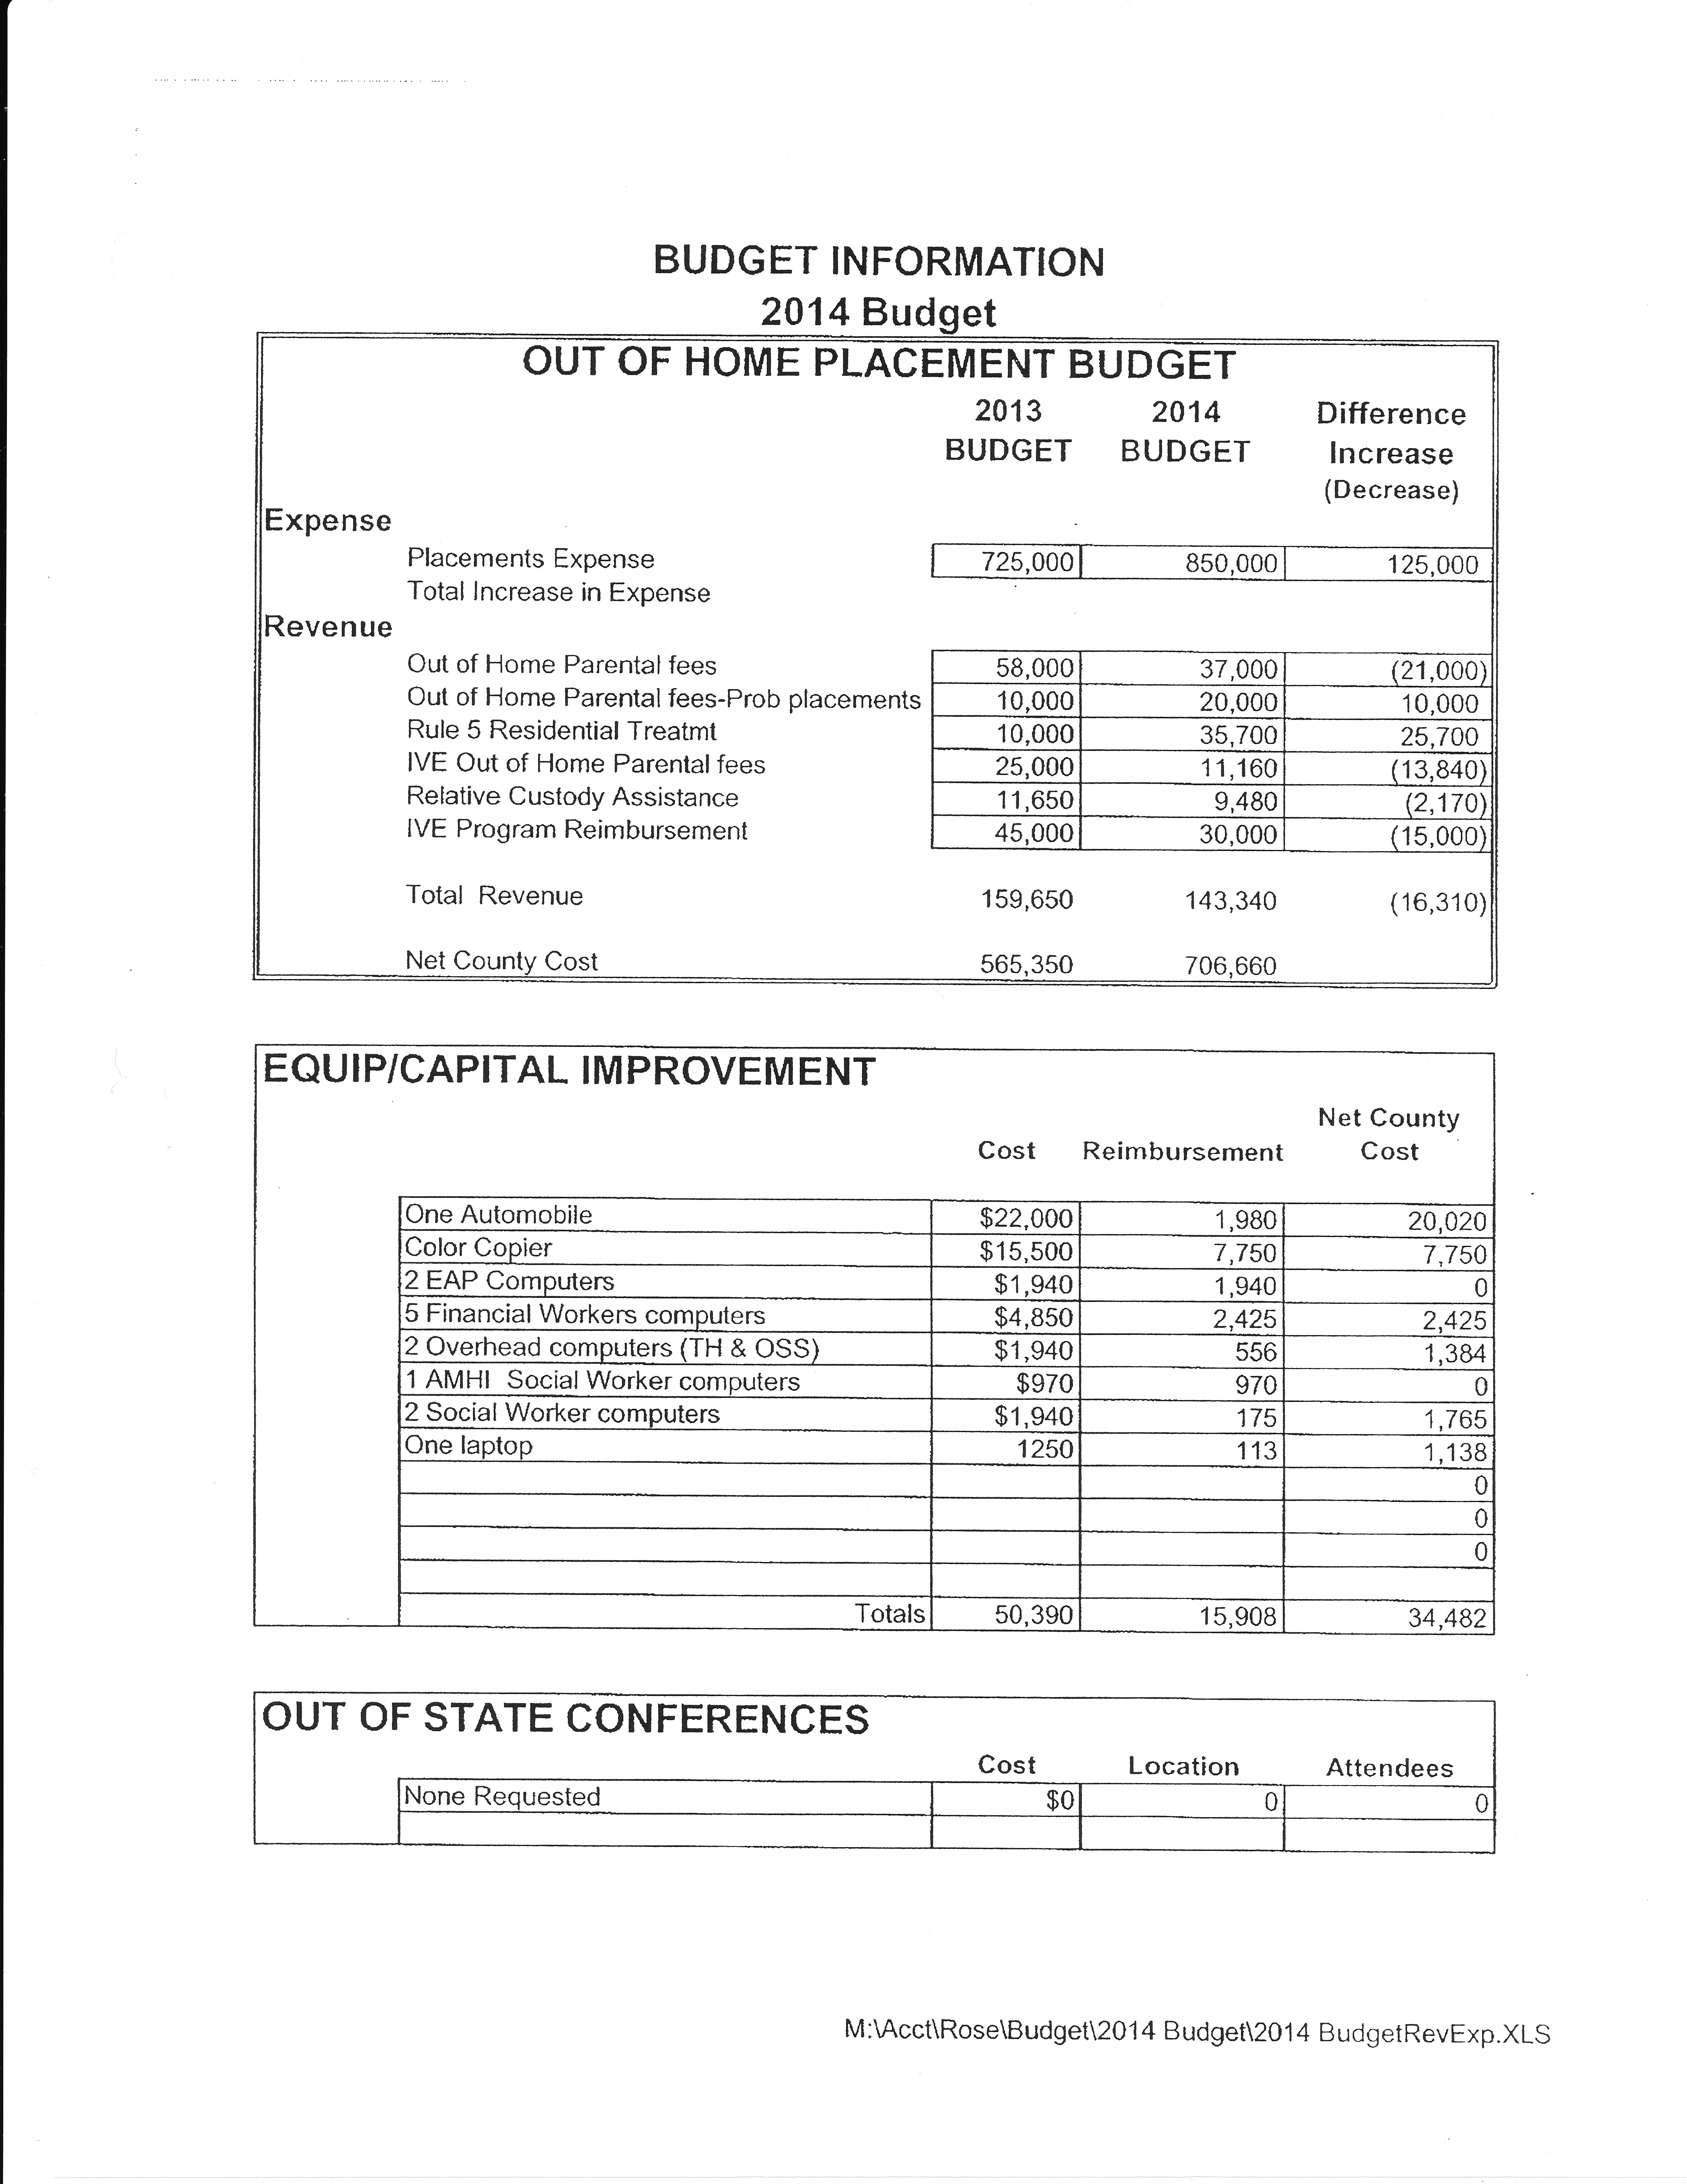
Brown County Budget – Out-of-Home Placement

Slide 15
Brown County Budget – Capital & Conferences

Slide 16
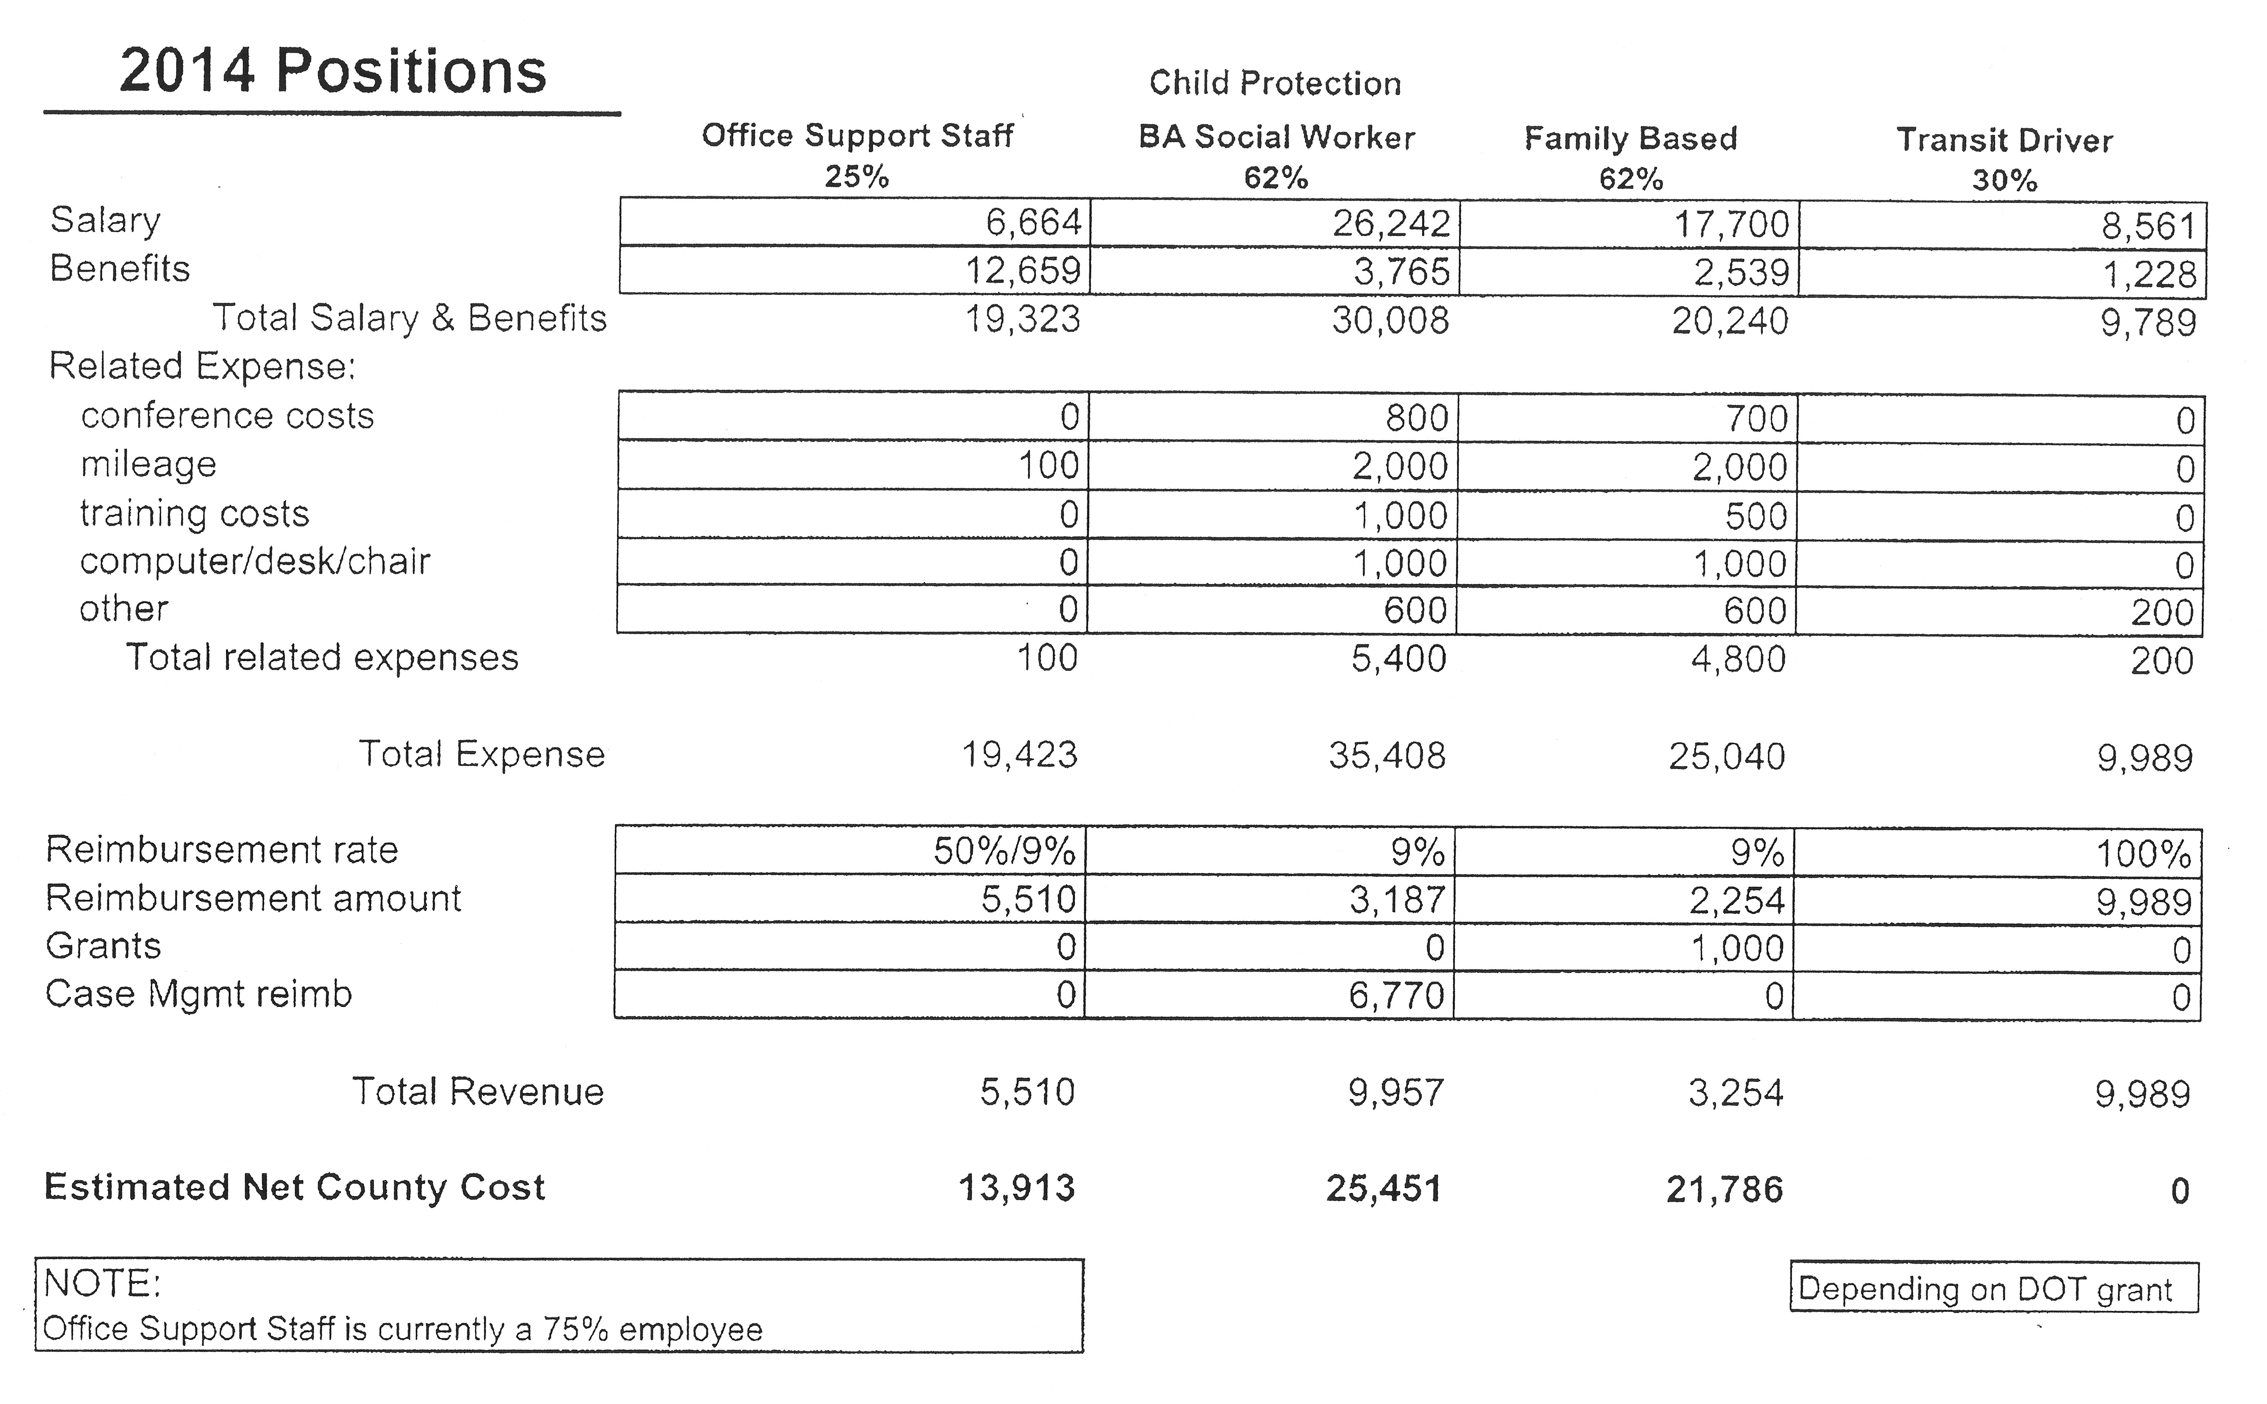
Brown County Budget – Positions

Slide 17
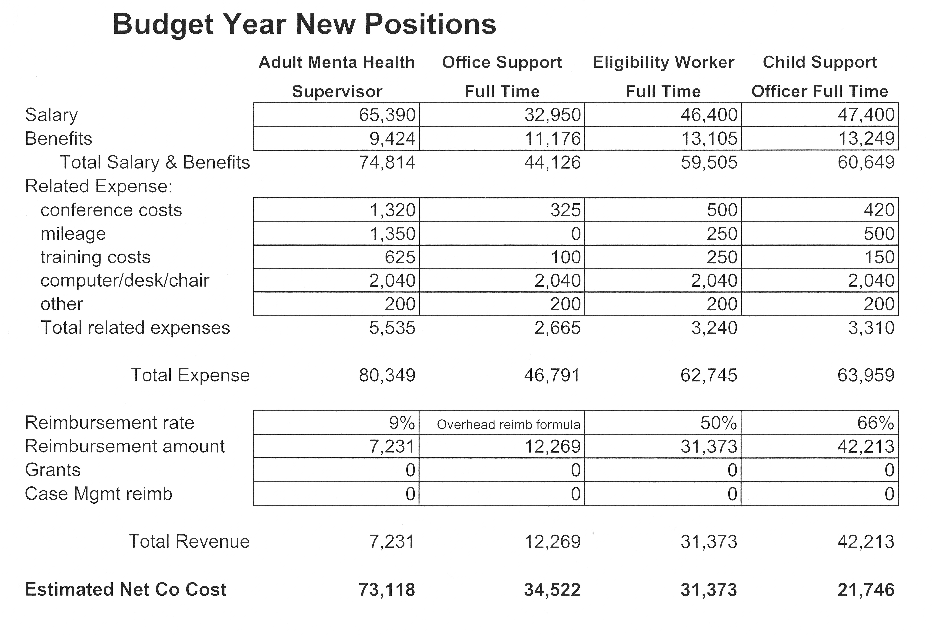
Brown County Budget – New Positions

Slide 18
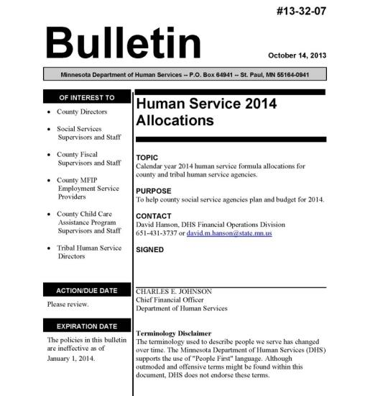
Annual DHS Allocations Bulletin

Slide 19
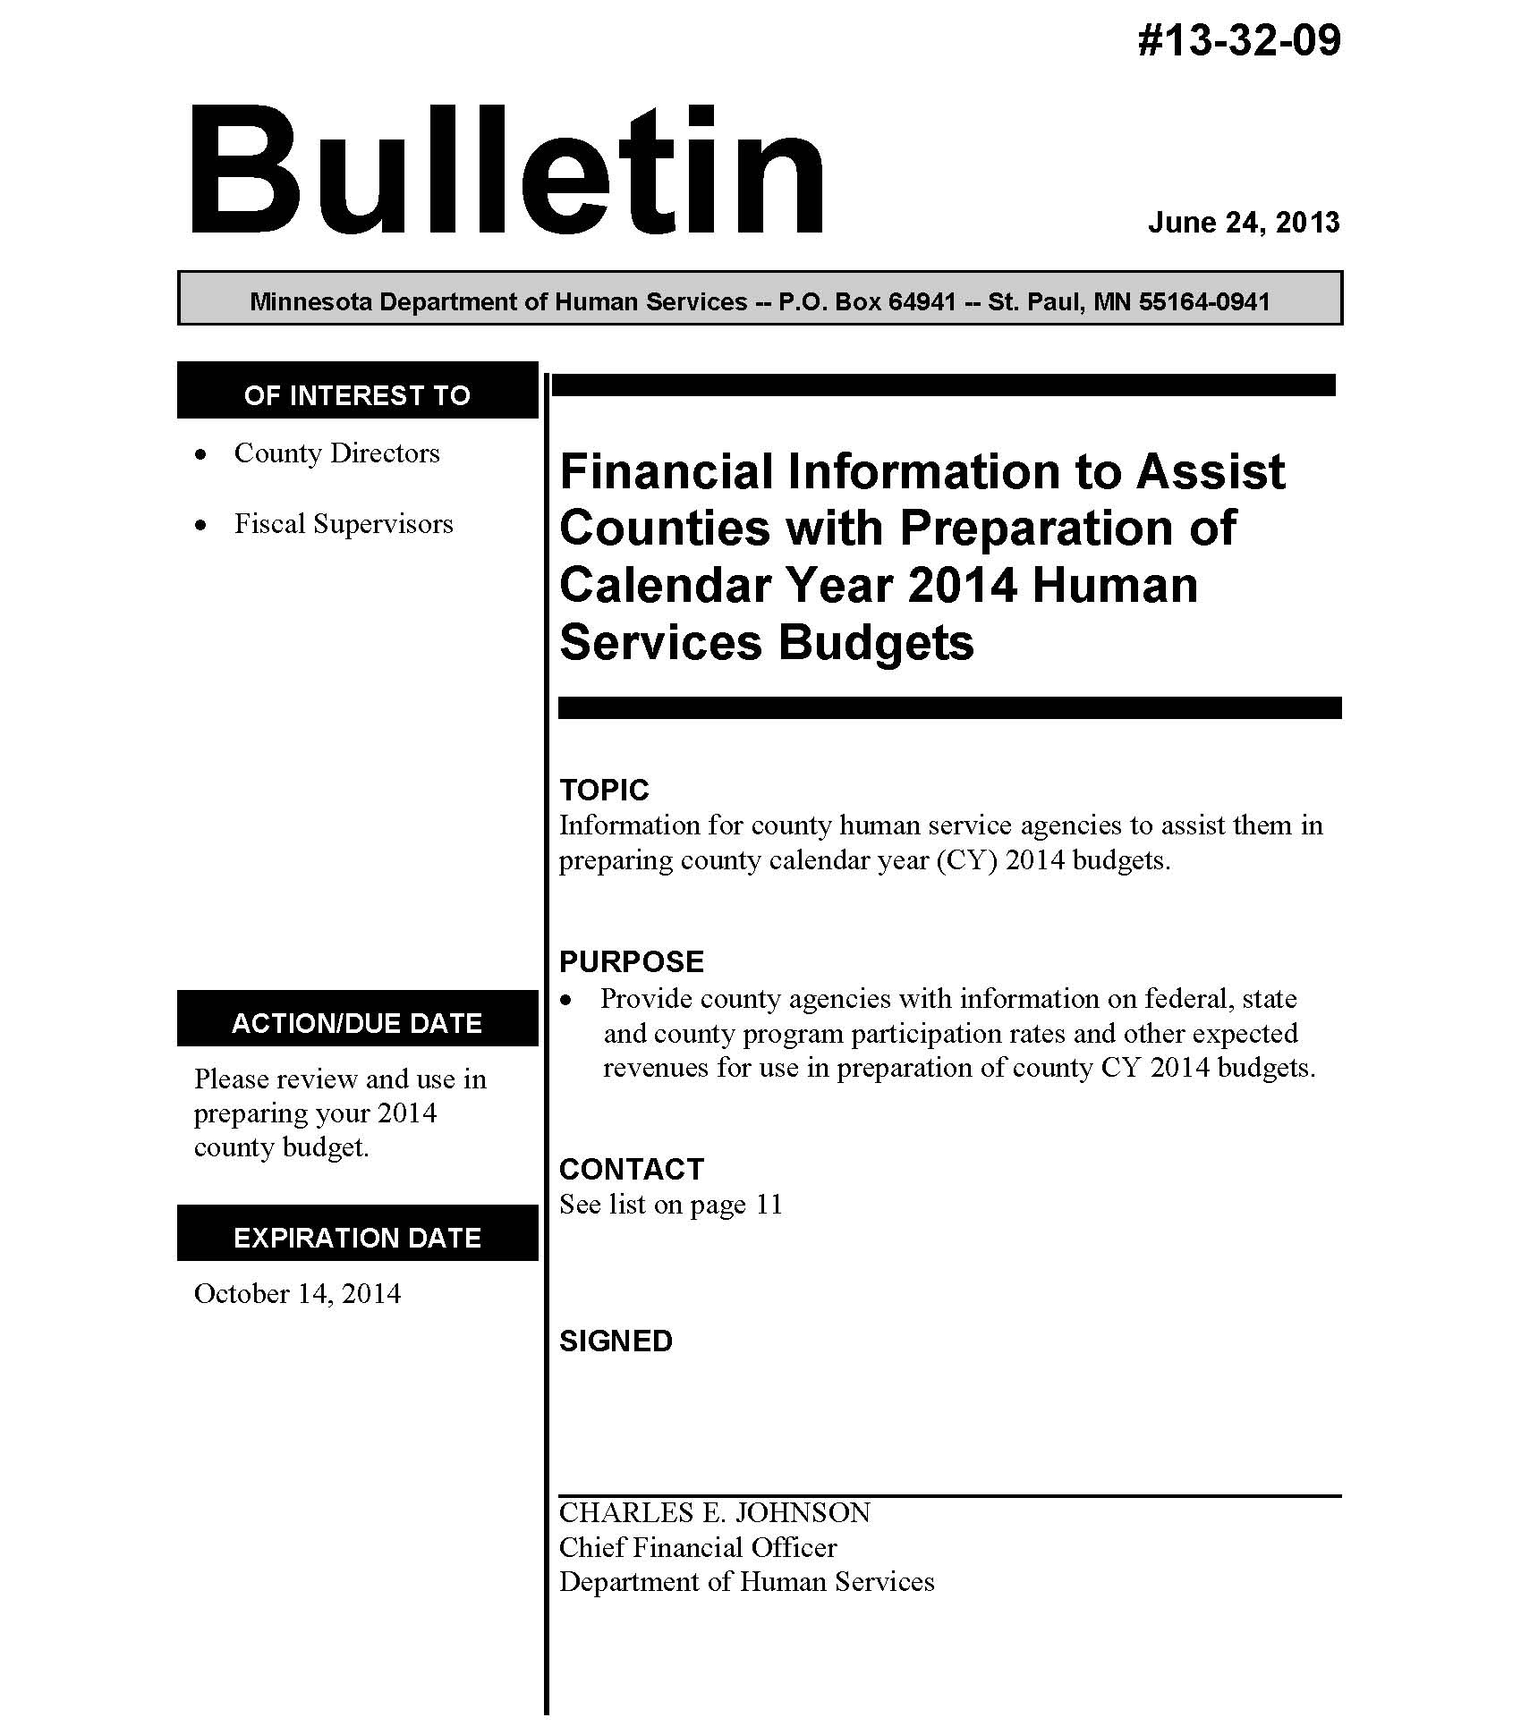
Annual DHS Budget Prep Bulletin

Slide 20
Budget Reserves
$
Fund location
Human Services Fund
Handled centrally at the countywide level
Level of granularity
General reserves
Specific set-asides
Take-away
Every county handles reserves differently.
Know how your county addresses them.

Slide 21
Budget Environment
The current budget environment makes a big difference.
Your approach will be quite different depending on the fiscal context.
No budget environment stays forever.
We look in general at three budget environments: Cutting, Steady, and Growth.
Much in common, but they each have unique challenges.

Slide 22
Budget Cutting Environment
It intuitively seems as though budget cutting would be the hardest, and no doubt it is.
It offers special challenges but also special opportunities.
We each draw on the last big round of major reductions in 2003 for lessons to remember for another time.

Slide 23
7 Lessons Learned from the 2003 Budget Cuts
by Tom Henderson – May 2005
Be a county team member – As a Human Services director, be a county team member in any way possible. Join in any early attempts county administrators or board members have to use a committee process to determine how budget cutting is going to be done. Get in on the early deliberations, try to be appointed to any positions that give you strength in the county budget process. Let the board, county administrator and others know that you understand what the county is up against, that you've studied the whole picture, and that you're ready to be a part of the solution, whatever that may mean for your department.
Emphasize revenue received in Human Service budgets as much as possible – Board members and administrators frequently think about cutting expenditures, which often means staff and contracts. Help them understand that the Human Services budget is a lot about raising revenues. Those revenues are lost and gained by earnings formulas that are affected by cuts that are made. Give them some scenarios that make it real for them.

Slide 24
7 Lessons Learned from the 2003 Budget Cuts
by Tom Henderson – May 2005
Take your share of county goals for staff cuts – You also need to put together clearly for the board members and administrator both the implications for lost revenues for positions dropped and lost services and what could happen to other non-staff costs when those services are no longer performed by county staff. An example might be dropping a county CD case manager only to have more clients languish and return to detox and treatment resources, which could have contracted county cost implications. These costs may go beyond what you have saved by eliminating the position, at least in county dollars.
Contract cutting – You need to get "inside" the contracted organization and have discussions about exactly what services are going to be reduced or changed and exactly how the cost reductions are going to be achieved in an agreeable fashion. If you just do across-the-board cuts and don't go further to decide exactly how those cost reductions are going to be achieved, you may end up with cost overruns the next year and/or delayed and temporary fixes in budgets that only-come back to haunt the contractor and the county as deficits and other problems show up in future Years. (STMHC Example)

Slide 25
7 Lessons Learned from the 2003 Budget Cuts
by Tom Henderson – May 2005
Out-of-home placement cost cutting — You have to get buy-in from all players in this area if you want long term success. That means buy-in from the county judicial branch, corrections and your social service children's unit. They must all adopt philosophies of out-of-home-placement that result in reductions in this area. Short-term quotas and crisis⁻management sometimes only put off placements, or when the staff realize the pressure is off, the placements come back, sometimes at a higher rate than ever before.
Revenue/fees increases – These can become real political "hot potatoes" with community and certain client groups when they are introduced without proper community preparation. Also, it takes staff to collect fees and that costs money too. Detoxification fees, out-of-home placement fees, and licensing child care fees have been a real asset in our budget, along with Medical Assistance collections.

Slide 26
7 Lessons Learned from the 2003 Budget Cuts
by Tom Henderson – May 2005
Expense reduction – For the most part, this is an area that has political muscle but not any real long lasting cash value. It's a feel good part of the budget to reduce conference attendance, mileage, pens and pencils and paper, but it has no long-term measurable-benefit. Eventually you still need to train your staff and you need to replace things that wear out and have supplies to get your work done. The one thing we did that really did have some long term reduction was to start using an agency-owned vehicle for long trips instead of paying staff the federal reimbursement rate. Otherwise, of all the things we did (and there were many) to save money here and there, none have had a major long-term effect. We were a low-cost/low-maintenance operation before and reducing it only forced all maintenance and reduced supplies to be put on hold and kept needed training from happening.

Slide 27
Ten Things I Learned from the 2003 Budget Cuts
by John Sellen – February 2005
Be as clear and open as possible about your criteria for cuts. Focus on what the county will continue paying for rather than what you don't get to pay for any more.
Lots of little cuts help, but to save a lot you also have to cut something deeply, and/or stop doing some things altogether.
Sound public investments in people or programs don't always pay off with savings in a short enough time frame, and the savings don't always show up in your budget.
It's good to have fund balance to even out the roller coaster, but you can't live on it.

Slide 28
Ten Things I Learned from the 2003 Budget Cuts
by John Sellen – February 2005
Start shutting off the obligation spigot early on.
Give staff positive things to do with their frustrations and worries.
Laying people off is hard:
  Have solid position control in place before eliminating positions.
  Stop hiring early on, even though the vacancies are random.
  Don't hand out pink slips until you're sure.
  Pay as much attention to those left behind as those sent away.

Slide 29
Ten Things I Learned from the 2003 Budget Cuts
by John Sellen – February 2005
Tackle performance issues (staff or providers) before there's a budget cutting problem. You don't want to tackle these together.
Re-engineering processes to save money is great, but it rarely works well when the cuts are really deep.
The Board doesn’t like to be the “bad guys”. Try to help them not be.

Slide 30
Steady Budget Environment
It seems as though a Steady Budget Environment might be the easiest, but that can be deceiving.
It’s simpler than budget cuts!
When everything stays steady, there are special challenges that require us to create opportunities.
Steady Budget
With no new money, you need to carve funds for innovation out of what you’re already spending, and it’s already “spoken for.

Slide 31
Steady Budget Environment
Need to sell Board on the need for innovation.
In this environment, innovation proposals work best when they save money.
But typically need short-term money to save money long-term.
Then you need to deliver on your sales pitch.
It’s a gamble, and can be tough for a new director to pull off.

Slide 32
Budget Growth Environment
A Budget Growth Environment is not common, but it happens.
More often in one program area rather than across the board.
It seems as though a Budget Growth Environment might be easy, and it does offer rare possibilities.
It also offers special challenges and hazards.

Slide 33

Budget Growth Environment
Budget Growth requires discipline so that new funds actually result in lasting changes.
Focus the growth on a few key areas or innovations.
Avoid the hazard of spreading it around too much, diluting it so that nothing changes.
Another hazard is that inexperience with growth can mean that you don’t get your money’s worth.

Slide 34
Collections
Collections involve the county efforts to collect every revenue, including those covered elsewhere in these videos.
For some revenue, the county keeps all of it.
For other revenue, the county keeps only a percentage of whatever’s collected.
Revenue recapture can make even old bills a source of revenue.

Slide 35
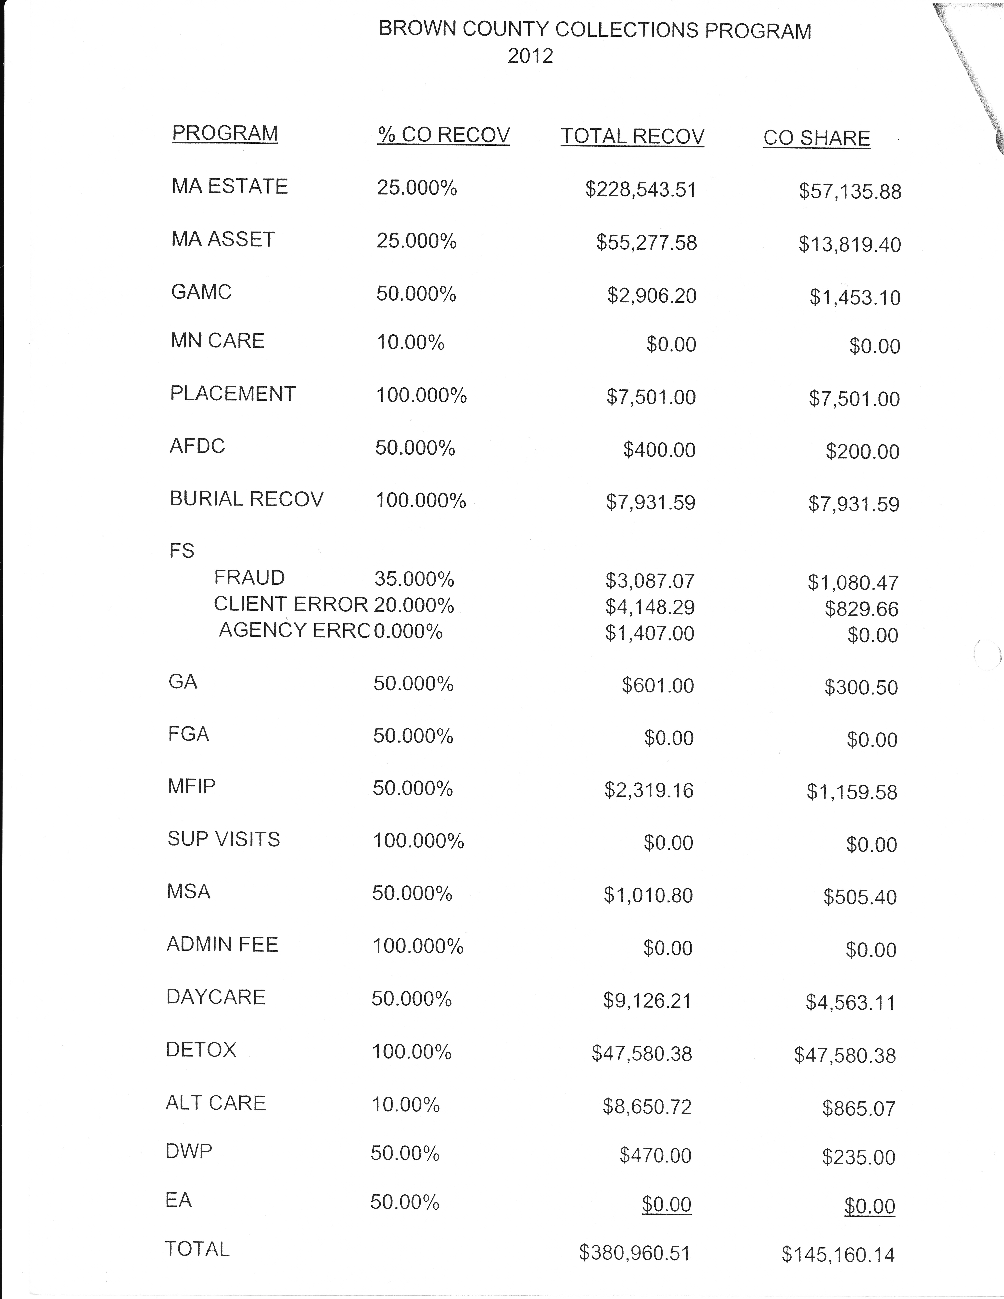
Collections – Brown County Example
Page 1

Slide 36
Collections – Brown County Example
Page 2

Slide 37
The Role of the Director
Central role of the director in fiscal and budgetary matters.
Need to rely on others.
Yet some things that no one else is well positioned to keep the agency focused on.
Since you have limited time and attention, here are some expenditures and some revenue to concentrate on.

Slide 38
“What Directors Should Watch For”
By Tom Henderson updated 2014
EXPENDITURES
Out of Home Placement
Administrative Structure Costs
SS/IM Ratio
Staff Transportation
State Hospital Costs
Caseloads

Slide 39
“What Directors Should Watch For”
By Tom Henderson updated 2014
REVENUE
TCM
Waiver CM Hours
SSTS and IM-RMS Random Moments
Detox – Fees and Insurance
MA Asset Recovery
MFIP State Grant
CMH Screening
Relocation Service Coordination
MN Choices – Random Moments
Family Assessment Grant
Out of Home Parental Fees
Redirects (CS/SS)
Rule 5 Residential Treatment
Title IV-E
Managed Care
Insurance

Slide 40
Introduction to Human Service Finance for Minnesota County Directors
Welcome, Overview, & Basic Concepts
Cash Assistance & Health Care
Social Services Fiscal Elements
Children’s Social Services
Adult Social Services
Budgeting & Conclusion
End of Video 6

Slide 41
End of Video 6

